Slide 1


History and Contemporary Application of the Mitsunobu Reaction
Aaron Chhun
CHEM180H
Fall 2023

Slide 2
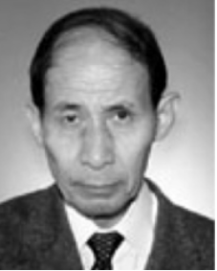

History
Oyo Mitsunobu (1934-2003)
  Synthetic organic chemist
  Aoyama Gakuin University, Tokyo
  102 Publications
  1747 citations
Discovered Mitsunobu Reaction in 1967:
Oyo Mitsunobu research with Aoyama Gakuin University and other places. ResearchGate, https://www.researchgate.net/scientific-contributions/Oyo-Mitsunobu-2011044068
Image Credit: The honour roll: Oyo Mitsunobu. https://amphoteros.com/2013/10/29/the-honour-roll-oyo-mitsunobu/
Image Credit: Aoyama Gakuin University. https://www.aoyama.ac.jp/en/
Notes:
Include range of research (blah blah, blah blah to blah blah)

Slide 3
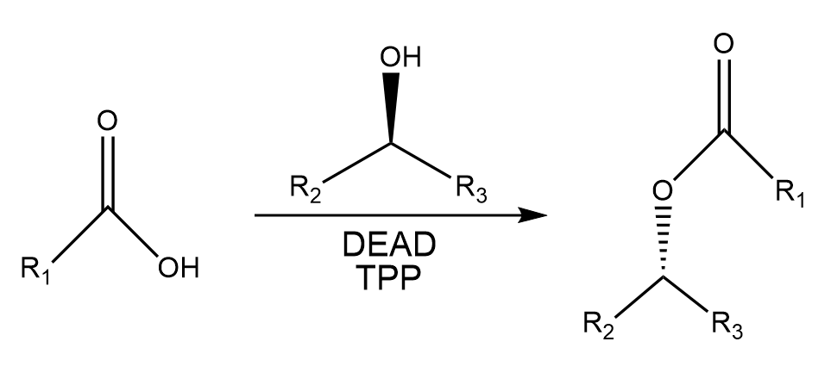
The First Mitsunobu
Preparation of Esters of Carboxylic and Phosphoric Acid via Quaternary Phosphonium Salts
Mitsunobu, O. et al. Preparation of Esters of Carboxylic and Phosphoric Acid via Quaternary Phosphonium Salts.Bulletin of the Chemical Society of Japan. 1967, 40(10), 2380-2382.
Notes:
Whats the big deal??? Looks like typical esterification of alcohol

Slide 4
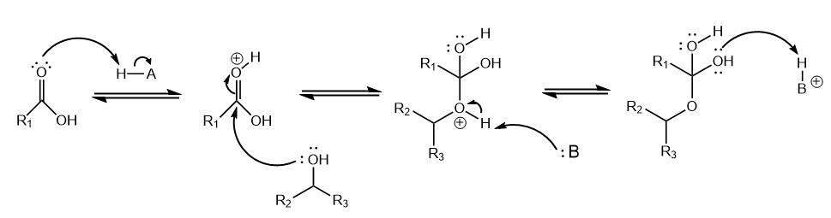

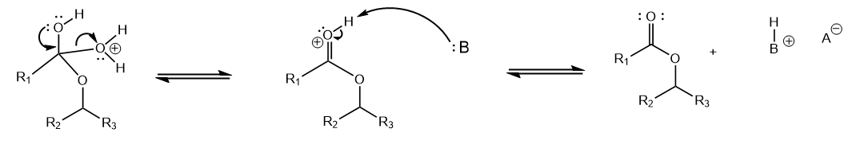
Fischer Esterification
Fischer Esterification. Organic Chemistry Portal. https://www.organic-chemistry.org/namedreactions/fischer-esterification.shtm

Slide 5
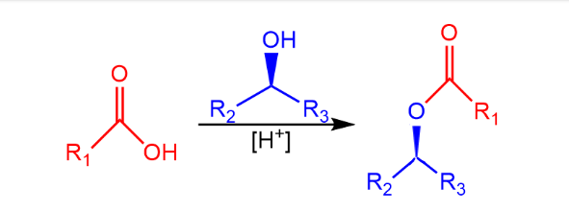
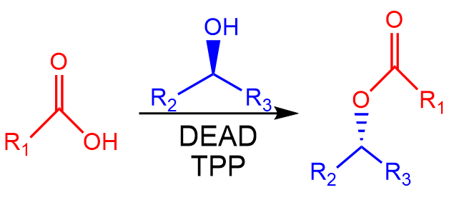
Significance
Fischer Esterification (1895)
Mitsunobu (1967)
Fischer Esterification. Organic Chemistry Portal. https://www.organic-chemistry.org/namedreactions/fischer-esterification.shtm
Mitsunobu, O. et al. Preparation of Esters of Carboxylic and Phosphoric Acid via Quaternary Phosphonium Salts.Bulletin of the Chemical Society of Japan. 1967, 40(10), 2380-2382.
Notes:
Briefly speak through “general” mechanism,,,,FIX ESTERIFICATION STEREOCHEMISTRY.

Slide 6
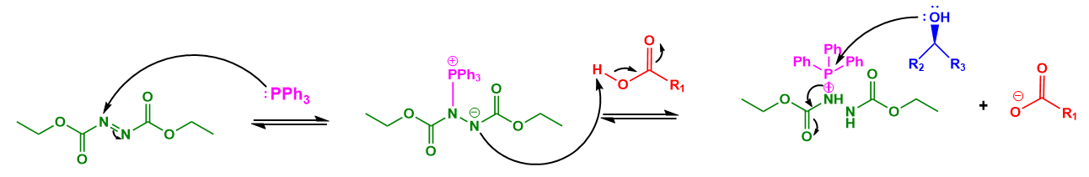
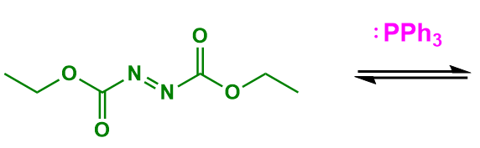
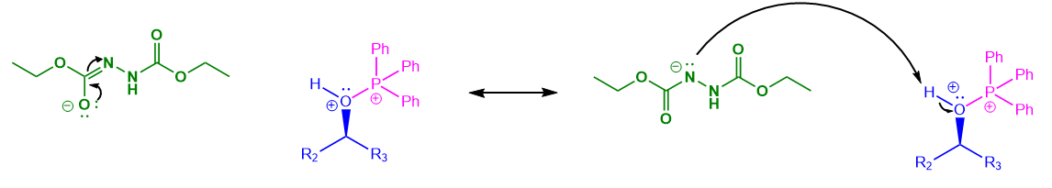
Mitsunobu Esterification
Mitsunobu, O. et al. Preparation of Esters of Carboxylic and Phosphoric Acid via Quaternary Phosphonium Salts.Bulletin of the Chemical Society of Japan. 1967, 40(10), 2380-2382.

Slide 7
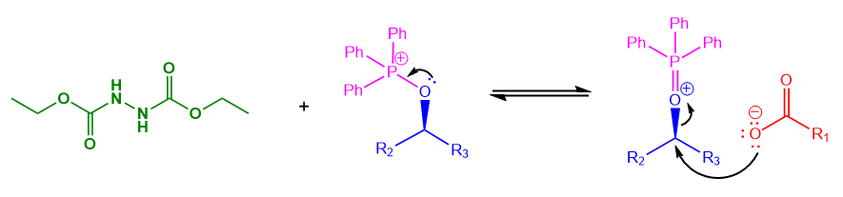

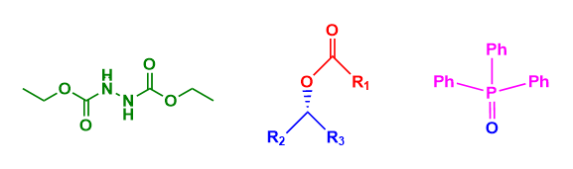
Mechanism (cont)
Mitsunobu, O. et al. Preparation of Esters of Carboxylic and Phosphoric Acid via Quaternary Phosphonium Salts.Bulletin of the Chemical Society of Japan. 1967, 40(10), 2380-2382.

Slide 8
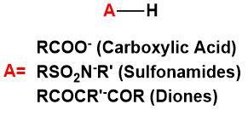
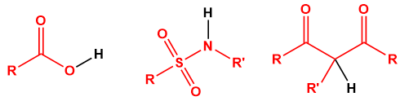
Strengths
Pronucleophiles (Can form C-O, C-N, C-C bonds)
  “pKA rule”
Stereospecificity via SN2 inversion
Mild rxn conditions
Fletcher, S. The Mitsunobu Reaction in the 21st century. Org. Chem. Front. 2015, 2, 739-752.
Swamy et a;. Mitsunobu and Related Reactions: Advances and Applications. 2009, 109 (6), 2551-2651.
Notes:
Pronucleophiles are molecules that are readily converted into nucleophiles. For Mitsunobu reactions, pKa of the pronucleophile must be roughly 12 or lower because the betaine (neutral molecule that consist of a non hydrogen including cationic group such as PPh3 and a negatively charged group) that is produced from the reaction of DEAD and PPh3 is roughly 12. Anion must be able to deprotonate HA (source of acidic proton) in order for reaction to work. If the pKa is higher than 12, alkylation of DEAD will occur instead.

Slide 9
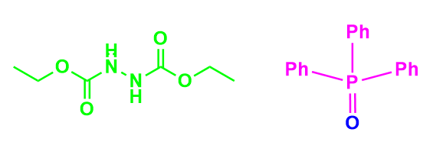
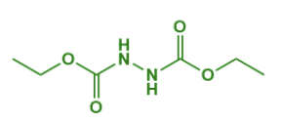
Reaction Hurdles
Purification woes
  DEAD-H2 and O=PPh3
Poor atom economy
Fletcher, S. The Mitsunobu Reaction in the 21st century. Org. Chem. Front. 2015, 2, 739-752.
Swamy et a;. Mitsunobu and Related Reactions: Advances and Applications. 2009, 109 (6), 2551-2651.

Slide 10
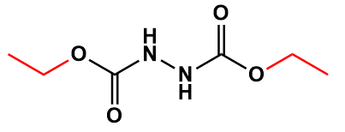
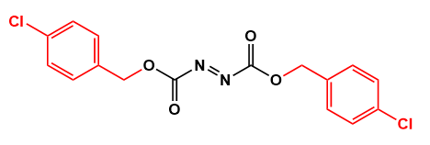
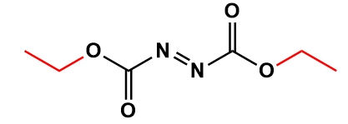
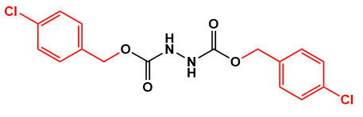


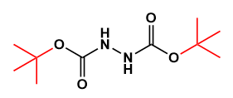
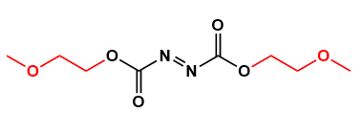
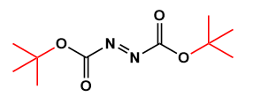
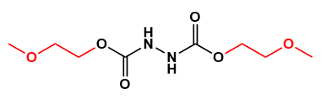
Reagent Modification (Azodicarbonyl)
Lipshutz, B. H. et al. Simplification of the Mitsunobu Reaction. Di-p-chlorobenzyl Azodicarboxylate: A New Azodicarboxylate. Org. Lett. 2006. 8 (22), 5069-5072.
Kiankarimi, M, et al. Diphenyl 2-Pyridylphosphine and Di-tert-butyl Azodicarboxylate: Convenient Reagents for the Mitsunobu Reaction. Tetrahedron Letters. 1999. 40, 4497-4500.
Hagiya, K. et al. DMEAD: a new dialkyl azodicarboxylate for the Mitsunobu reaction. Tetrahedron Letters. 2009. 65, 6109-6114.

Slide 11
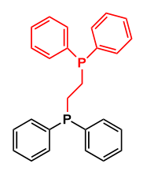
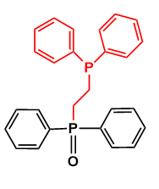
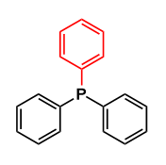
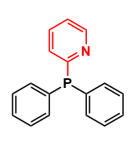
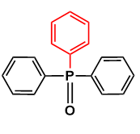
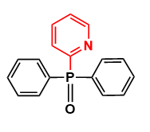

Reagent Modification (Phosphine)
Kiankarimi, M, et al. Diphenyl 2-Pyridylphosphine and Di-tert-butyl Azodicarboxylate: Convenient Reagents for the Mitsunobu Reaction. Tetrahedron Letters. 1999. 40, 4497-4500.
O’ Neil, I, et al. DPPE: A Convenient Replacement for Triphenylphosphine in the Staudinger and Mitsunobu Reactions. Tetrahedron Letters. 1998. 39, 7787-7790.

Slide 12
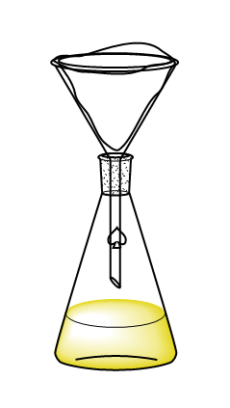
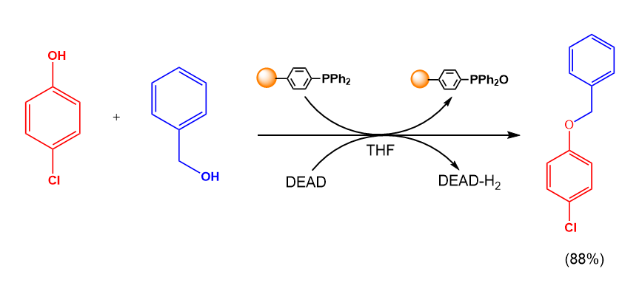
Solid-Phase Mitsunobu
Dandapani, S. Separation-Friendly Mitsunobu Reactions: A Microcosm of Recent Developments in Separation Strategies. European Chemical Societies Publishing. 2004. 10(13), 3139-3138.
Tunoori, A, et al. Polymer-bound triphenylphosphine as traceless reagent for mitsunobu reactions in combinatorial chemistry: Synthesis of aryl ethers from phenols and alcohols. Tetrahedron Letters. 1998. 39 (48), 8751-8754.

Slide 13
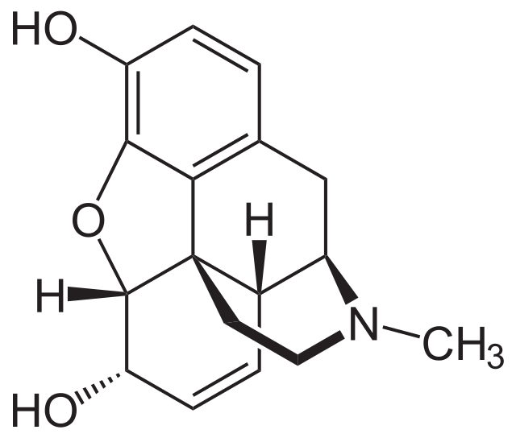
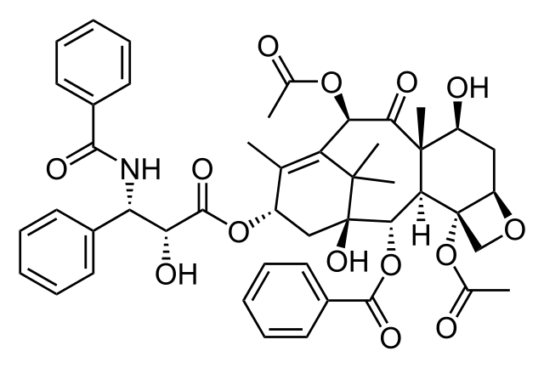
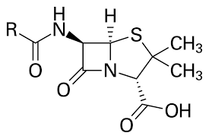
Contemporary Uses
Natural product synthesis
  Pharmacotherapy and Drug Discovery
  Organic compounds involved in secondary metabolism
Penicillin
Morphine
Paclitaxel
Atanasov, G, et al. Natural products in drug discovery: advances and opportunities. Nature. 2021. 20, 200-216.
mage credit: Penicillin.https://en.wikipedia.org/wiki/Penicillin
Image credit: Morphine. https://en.wikipedia.org/wiki/Morphine
Image credit: Paclitaxel. https://en.wikipedia.org/wiki/Paclitaxel

Slide 14
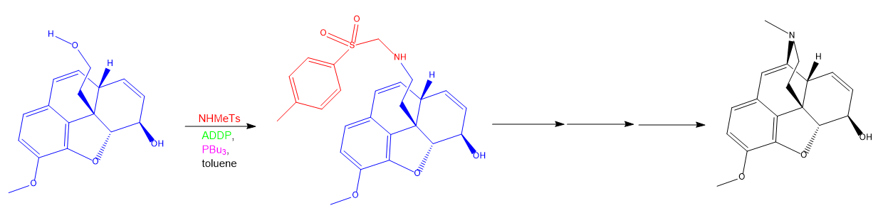
Contemporary Uses (cont)
Mitsunobu involved in synthesis of:
  Cannabidiol derivative
  Alkaloids
ADDP
Primary alcohol
Sulfonamide
Morphine
Zhang, Q. et al. Enantioselective synthesis of cis-hydrobenzofurans bearing all-carbon quaternary stereocenters and application to total synthesis of (-)-morphine. Nat Commun. 2019; 10, 2507.
Munawar, S, et al. Mitsunobu Reaction: A Powerful Tool for the Synthesis of Natural Products: A Review. Molecules. 2022. 27 (20), 6953.

Slide 15
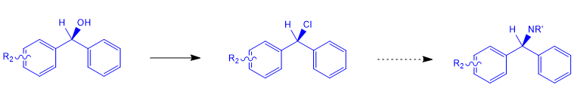
Contemporary Use (Maitra)
Synthesis of biaryl methyl amines:

Slide 16
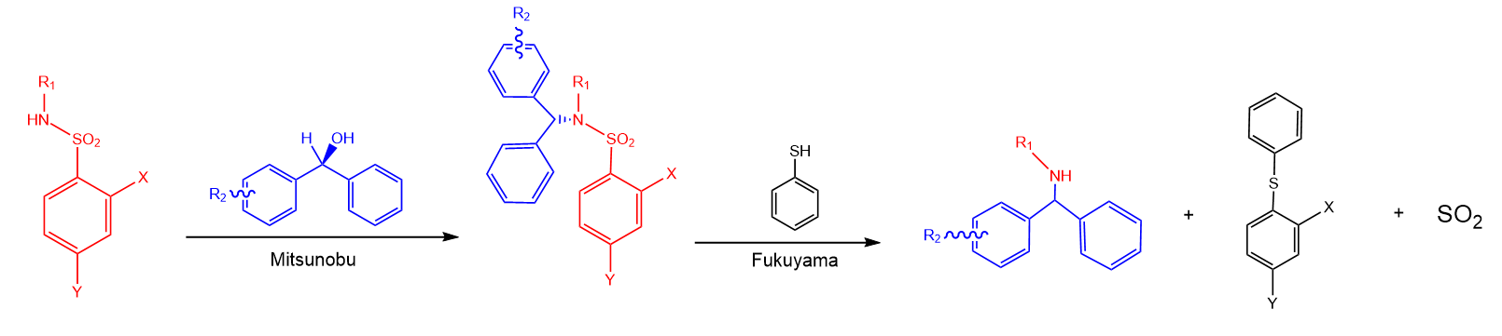

Alternative Route
Fukuyama Reaction: prepare secondary amines with 2- and 4-nitrobenzene sulfonamides and thiophenol
Fukuyama, T, et al. 2- and 4-Nitrobenzenesulfonamides: Exceptionally versatile means for preparation of secondary amines and protection of amines. Tetrahedron Letters. 1995. 36 (36), 6373-6374.

Slide 17
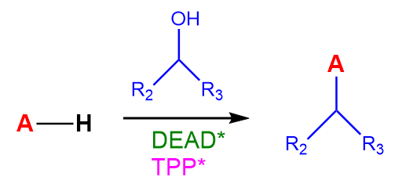
Summary
Versatile and stereospecific
Difficult purification and poor atom economy
Reagent modification and solid-phase chemistry
Used in synthesis of natural products
* Potential for modified reagent

Slide 18
References
Mitsunobu, O. et al. Preparation of Esters of Carboxylic and Phosphoric Acid via Quaternary Phosphonium Salts.Bulletin of the Chemical Society of Japan. 1967, 40(10), 2380-2382.
Fischer Esterification. Organic Chemistry Portal. https://www.organic-chemistry.org/namedreactions/fischer-esterification.shtm
Fletcher, S. The Mitsunobu Reaction in the 21st century. Org. Chem. Front. 2015, 2, 739-752.
Swamy et a;. Mitsunobu and Related Reactions: Advances and Applications, 2009. 109 (6), 2551-2651.
Kiankarimi, M, et al. Diphenyl 2-Pyridylphosphine and Di-tert-butyl Azodicarboxylate: Convenient Reagents for the Mitsunobu Reaction. Tetrahedron Letters. 1999. 40, 4497-4500.
Hagiya, K. et al. DMEAD: a new dialkyl azodicarboxylate for the Mitsunobu reaction. Tetrahedron Letters. 2009. 65, 6109-6114.
Dandapani, S. Separation-Friendly Mitsunobu Reactions: A Microcosm of Recent Developments in Separation Strategies. European Chemical Societies Publishing. 2004. 10(13), 3139-3138.
Tunoori, A, et al. Polymer-bound triphenylphosphine as traceless reagent for mitsunobu reactions in combinatorial chemistry: Synthesis of aryl ethers from phenols and alcohols. Tetrahedron Letters. 1998. 39 (48), 8751-8754.
Zhang, Q. et al. Enantioselective synthesis of cis-hydrobenzofurans bearing all-carbon quaternary stereocenters and application to total synthesis of (-)-morphine. Nat Commun. 2019; 10, 2507.
Atanasov, G, et al. Natural products in drug discovery: advances and opportunities. Nature. 2021. 20, 200-216.
Munawar, S, et al. Mitsunobu Reaction: A Powerful Tool for the Synthesis of Natural Products: A Review. Molecules. 2022. 27 (20), 6953.
Fukuyama, T, et al. 2- and 4-Nitrobenzenesulfonamides: Exceptionally versatile means for preparation of secondary amines and protection of amines. Tetrahedron Letters. 1995. 36 (36), 6373-6374.

Slide 19
Acknowledgements:
Dr. Maitra and the Maitra Group
Dr. Krishnan
Department of Chemistry and Biochemistry

