Slide 1
An Investigation of Effective Natural Supplements in Promoting Ethanol Soberness via Drosophila melanogaster
Aaron Asparin
CHEM 180H

Slide 2
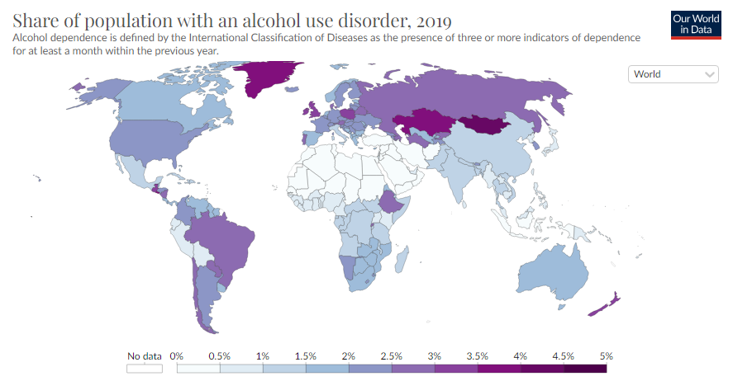
Alcoholism in the World-Wide
(1) Ritchie, H.; Roser, M. Alcohol Consumption. Our World in Data 2018.
(2) Alcohol Abuse Statistics [2023]: National + State Data. NCDAS. https://drugabusestatistics.org/alcohol-abuse-statistics/ (accessed 2023-10-09).
(3) Alcohol. https://www.who.int/news-room/fact-sheets/detail/alcohol (accessed 2023-10-09).
Notes:
https://ourworldindata.org/alcohol-consumption
https://drugabusestatistics.org/alcohol-abuse-statistics/
https://www.who.int/news-room/fact-sheets/detail/alcohol
107 million people have an AUD
2.8 million premature deaths per year (6% global deaths)
7.7% of all male global deaths
2.6% of all female global deaths

Slide 3
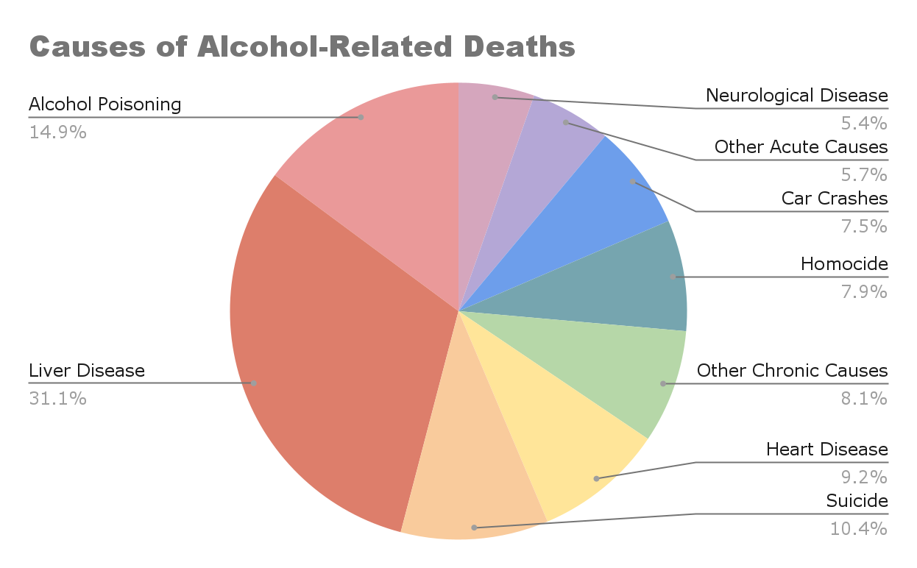
Alcoholism in the United States
(1) Ritchie, H.; Roser, M. Alcohol Consumption. Our World in Data 2018.
(2) Alcohol Abuse Statistics [2023]: National + State Data. NCDAS. https://drugabusestatistics.org/alcohol-abuse-statistics/ (accessed 2023-10-09).
(3) Alcohol. https://www.who.int/news-room/fact-sheets/detail/alcohol (accessed 2023-10-09).
(4) Alcohol Use Disorder (AUD) in the United States: Age Groups and Demographic Characteristics | National Institute on Alcohol Abuse and Alcoholism (NIAAA). https://www.niaaa.nih.gov/alcohols-effects-health/alcohol-topics/alcohol-facts-and-statistics/alcohol-use-disorder-aud-united-states-age-groups-and-demographic-characteristics (accessed 2023-10-09).
(5) Alcohol-Related Emergencies and Deaths in the United States | National Institute on Alcohol Abuse and Alcoholism (NIAAA). https://www.niaaa.nih.gov/alcohols-effects-health/alcohol-topics/alcohol-facts-and-statistics/alcohol-related-emergencies-and-deaths-united-states (accessed 2023-10-09).
Notes:
https://www.niaaa.nih.gov/alcohols-effects-health/alcohol-topics/alcohol-facts-and-statistics/alcohol-use-disorder-aud-united-states-age-groups-and-demographic-characteristics
https://www.niaaa.nih.gov/alcohols-effects-health/alcohol-topics/alcohol-facts-and-statistics/alcohol-related-emergencies-and-deaths-united-states
https://ourworldindata.org/alcohol-consumption
https://www.who.int/news-room/fact-sheets/detail/alcohol
https://drugabusestatistics.org/alcohol-abuse-statistics/#:~:text=Every%20day%2C%20385%20Americans%20die,a%20result%20of%20alcohol%20abuse.
28.6 million 18+ Americans had AUD
(11.3% in that age group)
140,000+ deaths related to alcohol annually

Slide 4
Ethanol Addiction
Alcoholism
Ethanol Withdrawal
1
Characterized by alcohol withdrawal syndrome
  Nausea, sweating, headaches, tachycardia
  Seizures and delirium tremens
Destruction of Synaptic Homeostasis
2
Abstinence: Alcohol-Withdrawal Syndrome
3
Current Treatments
Influx of negative ions into neuronal membranes
  Benzodiazepines
  Barbiturates
    Phenobarbital
Treatment
4
(6) Umar, Z.; Haseeb ul Rasool, M.; Muhammad, S.; Yousaf, S.; Nassar, M.; Ilyas, U.; Hosna, A. U.; Parikh, A.; Bhangal, R.; Ahmed, N.; Ariyaratnam, J.; Trandafirescu, T. Phenobarbital and Alcohol Withdrawal Syndrome: A Systematic Review and Meta-Analysis. Cureus 15 (1), e33695. https://doi.org/10.7759/cureus.33695.
(7) Addolorato, G.; Leggio, L.; Hopf, F. W.; Diana, M.; Bonci, A. Novel Therapeutic Strategies for Alcohol and Drug Addiction: Focus on GABA, Ion Channels and Transcranial Magnetic Stimulation. Neuropsychopharmacol 2012, 37 (1), 163–177. https://doi.org/10.1038/npp.2011.216.
(8) Understanding Alcohol Use Disorder | National Institute on Alcohol Abuse and Alcoholism (NIAAA). https://www.niaaa.nih.gov/publications/brochures-and-fact-sheets/understanding-alcohol-use-disorder (accessed 2023-10-11).
Notes:
https://www.ncbi.nlm.nih.gov/pmc/articles/PMC9922035/#:~:text=Since%20patients%20with%20alcohol%20use,management%20of%20alcohol%20withdrawal%20syndrome
Find out how benzodiazepine works for treatment, and also mention that patients with alcohol use disorder have benzodiazepine resistance
New Sources:
https://www.niaaa.nih.gov/publications/brochures-and-fact-sheets/understanding-alcohol-use-disorder
https://www.ncbi.nlm.nih.gov/pmc/articles/PMC9922035/#:~:text=Since%20patients%20with%20alcohol%20use,management%20of%20alcohol%20withdrawal%20syndrome
https://www.nature.com/articles/npp2011216

Slide 5
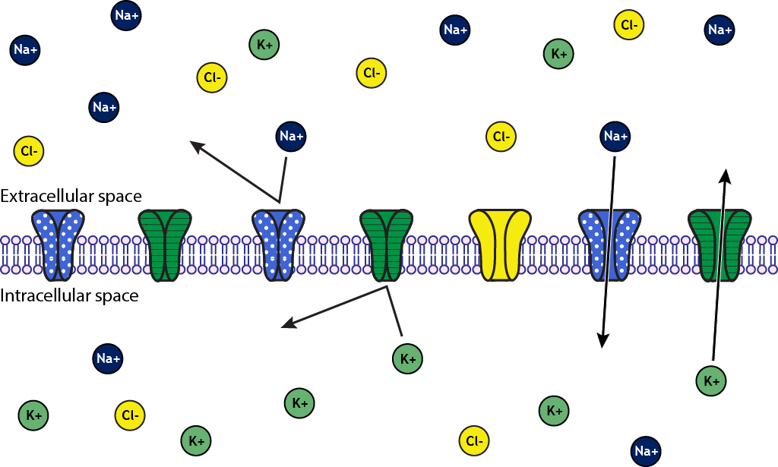
Treatment Methodology
(9) Henley, C. The Membrane at Rest. 2021.
(10) Ho, I. K.; Yu, S. Effects of Barbiturates on GABA System: Comparison to Alcohol and Benzodiazepines. The Keio Journal of Medicine 1991, 40 (4), 183–186. https://doi.org/10.2302/kjm.40.183.
(11) Kumar, S.; Porcu, P.; Werner, D. F.; Matthews, D. B.; Diaz-Granados, J. L.; Helfand, R. S.; Morrow, A. L. The Role of GABAA Receptors in the Acute and Chronic Effects of Ethanol: A Decade of Progress. Psychopharmacology (Berl) 2009, 205 (4), 529. https://doi.org/10.1007/s00213-009-1562-z.
Notes:
Image:
https://openbooks.lib.msu.edu/neuroscience/chapter/the-membrane-at-rest/
New sources:
https://www.ncbi.nlm.nih.gov/pmc/articles/PMC2814770/
https://www.jstage.jst.go.jp/article/kjm1952/40/4/40_4_183/_article/-char/ja/

Slide 6
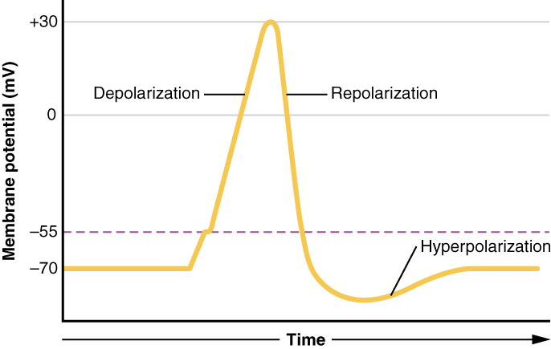
Treatment Methodology
(6) Umar, Z.; Haseeb ul Rasool, M.; Muhammad, S.; Yousaf, S.; Nassar, M.; Ilyas, U.; Hosna, A. U.; Parikh, A.; Bhangal, R.; Ahmed, N.; Ariyaratnam, J.; Trandafirescu, T. Phenobarbital and Alcohol Withdrawal Syndrome: A Systematic Review and Meta-Analysis. Cureus 15 (1), e33695. https://doi.org/10.7759/cureus.33695.
(12) Grider, M. H.; Jessu, R.; Kabir, R. Physiology, Action Potential. In StatPearls; StatPearls Publishing: Treasure Island (FL), 2023.
Notes:
Image:
https://www.ncbi.nlm.nih.gov/books/NBK538143/#:~:text=An%20action%20potential%20is%20a,the%20permeability%20of%20each%20ion.
New sources:
https://www.ncbi.nlm.nih.gov/pmc/articles/PMC9922035/#:~:text=Since%20patients%20with%20alcohol%20use,management%20of%20alcohol%20withdrawal%20syndrome

Slide 7
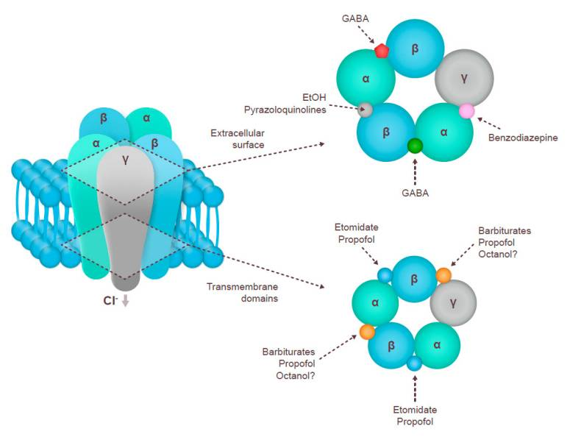
Gamma-aminobutyric acid (GABA)
GABA Receptor Modulation
Multiple binding sites
  GABA
  Ethanol
  Benzodiazepine
  Barbiturates
Focus-site is α1-GABA_{A}
Chloride ion channel
(11) Kumar, S.; Porcu, P.; Werner, D. F.; Matthews, D. B.; Diaz-Granados, J. L.; Helfand, R. S.; Morrow, A. L. The Role of GABAA Receptors in the Acute and Chronic Effects of Ethanol: A Decade of Progress. Psychopharmacology (Berl) 2009, 205 (4), 529. https://doi.org/10.1007/s00213-009-1562-z.
(13) Bruni, O.; Ferini-Strambi, L.; Giacomoni, E.; Pellegrino, P. Herbal Remedies and Their Possible Effect on the GABAergic System and Sleep. Nutrients 2021, 13 (2), 530. https://doi.org/10.3390/nu13020530.
Notes:
Image: https://www.ncbi.nlm.nih.gov/pmc/articles/PMC7914492/
https://www.ncbi.nlm.nih.gov/pmc/articles/PMC2814770/

Slide 8
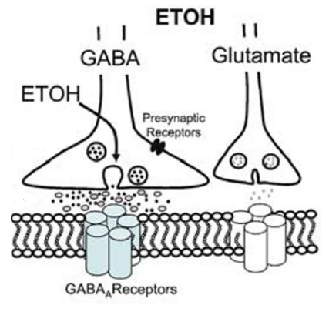
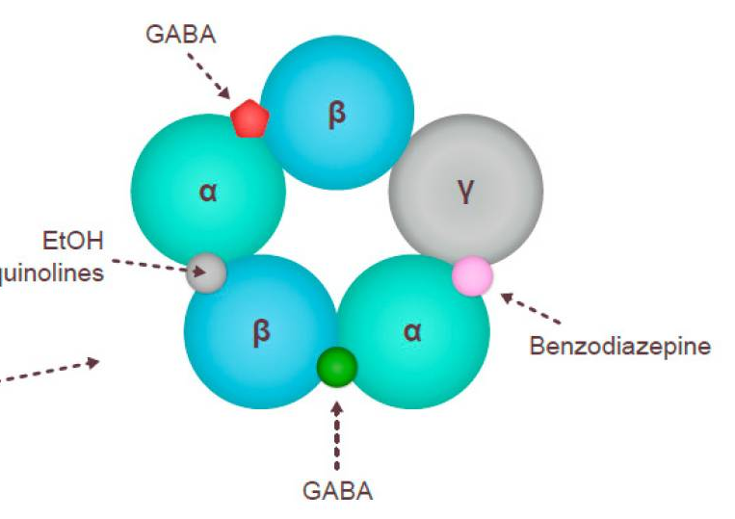


Ethanol & GABA Interactions
(13) Bruni, O.; Ferini-Strambi, L.; Giacomoni, E.; Pellegrino, P. Herbal Remedies and Their Possible Effect on the GABAergic System and Sleep. Nutrients 2021, 13 (2), 530. https://doi.org/10.3390/nu13020530.
(14) Criswell, H. E.; Breese, G. R. A Conceptualization of Integrated Actions of Ethanol Contributing to Its GABAmimetic Profile: A Commentary. Neuropsychopharmacol 2005, 30 (8), 1407–1425. https://doi.org/10.1038/sj.npp.1300750.
Notes:
Image: https://www.ncbi.nlm.nih.gov/pmc/articles/PMC7914492/
https://www.nature.com/articles/1300750

Slide 9
Pharmacotherapy
Direct Ion-Channel Drug Therapeutics
Broad number of physiological effects
  Negative or fatal
Natural Supplements
Chamomile (Matricaria sp.)
Chinese magnolia vine (Schisandra chinensis)
Lotus (Nelumbo nucifera)
Drumstick tree (Moringa oleifera)
Barbiturates (Phenobarbital)
Mimics the effects of ethanol on GABA
Already used in hospitals
CONS:
  Scheduled Drug
  High potential for addiction
(7) Addolorato, G.; Leggio, L.; Hopf, F. W.; Diana, M.; Bonci, A. Novel Therapeutic Strategies for Alcohol and Drug Addiction: Focus on GABA, Ion Channels and Transcranial Magnetic Stimulation. Neuropsychopharmacol 2012, 37 (1), 163–177. https://doi.org/10.1038/npp.2011.216.
(10) Ho, I. K.; Yu, S. Effects of Barbiturates on GABA System: Comparison to Alcohol and Benzodiazepines. The Keio Journal of Medicine 1991, 40 (4), 183–186. https://doi.org/10.2302/kjm.40.183.
(13) Bruni, O.; Ferini-Strambi, L.; Giacomoni, E.; Pellegrino, P. Herbal Remedies and Their Possible Effect on the GABAergic System and Sleep. Nutrients 2021, 13 (2), 530. https://doi.org/10.3390/nu13020530.
Notes:
https://www.nature.com/articles/npp2011216
https://www.ncbi.nlm.nih.gov/pmc/articles/PMC7914492/
New sources:
https://www.jstage.jst.go.jp/article/kjm1952/40/4/40_4_183/_article/-char/ja/

Slide 10
Drosophila melanogaster as a Method for Analysis
01
DEVELOPMENT
Ethanol-laced food
02
TOLERANCE TEST #1
Tolerance Testing
Behavioral Soberness Test
Independents:
  Nothing
  Baclofen
  Natural Supplements
03
EXPERIMENTAL
GABA-acting food
04
TOLERANCE TEST #2
Behavioral Soberness Test
(11) Kumar, S.; Porcu, P.; Werner, D. F.; Matthews, D. B.; Diaz-Granados, J. L.; Helfand, R. S.; Morrow, A. L. The Role of GABAA Receptors in the Acute and Chronic Effects of Ethanol: A Decade of Progress. Psychopharmacology (Berl) 2009, 205 (4), 529. https://doi.org/10.1007/s00213-009-1562-z.
(13) Bruni, O.; Ferini-Strambi, L.; Giacomoni, E.; Pellegrino, P. Herbal Remedies and Their Possible Effect on the GABAergic System and Sleep. Nutrients 2021, 13 (2), 530. https://doi.org/10.3390/nu13020530.
(15) Kaun, K. R.; Devineni, A. V.; Heberlein, U. Drosophila Melanogaster as a Model to Study Drug Addiction. Hum. Genet. 2012, 131 (6), 959–975. https://doi.org/10.1007/s00439-012-1146-6.
Notes:
https://www.ncbi.nlm.nih.gov/pmc/articles/PMC7914492/
https://www.ncbi.nlm.nih.gov/pmc/articles/PMC2814770/
Kuhn et al from the CHEM160 presentation

Slide 11
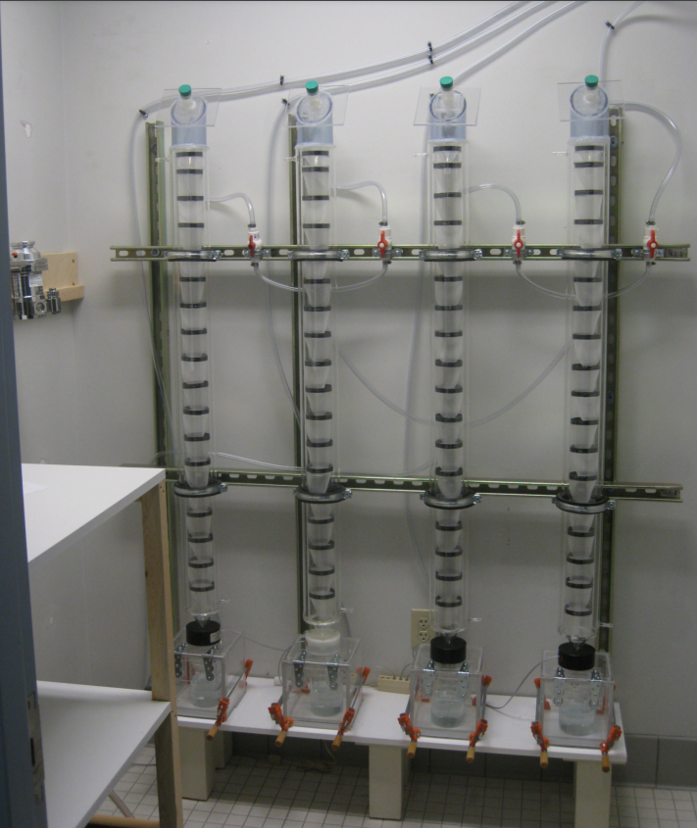
Tolerance Testing
Inebriometric Measurement
Can be varied in complexity
Will perform standardizations at different L/min of 95% EtOH
Acute Functional Tolerance
Qualitative measurement
Behavioral assay
  Motor coordination
  Loss of righting reflex
(11) Kumar, S.; Porcu, P.; Werner, D. F.; Matthews, D. B.; Diaz-Granados, J. L.; Helfand, R. S.; Morrow, A. L. The Role of GABAA Receptors in the Acute and Chronic Effects of Ethanol: A Decade of Progress. Psychopharmacology (Berl) 2009, 205 (4), 529. https://doi.org/10.1007/s00213-009-1562-z.
(16) Dawson, A. G.; Heidari, P.; Gadagkar, S. R.; Murray, M. J.; Call, G. B. An Airtight Approach to the Inebriometer. Fly (Austin) 2013, 7 (2), 112–117. https://doi.org/10.4161/fly.24142.
(17) Moore, M. S.; DeZazzo, J.; Luk, A. Y.; Tully, T.; Singh, C. M.; Heberlein, U. Ethanol Intoxication in Drosophila: Genetic and Pharmacological Evidence for Regulation by the cAMP Signaling Pathway. Cell 1998, 93 (6), 997–1007. https://doi.org/10.1016/S0092-8674(00)81205-2.
Notes:
https://www.ncbi.nlm.nih.gov/pmc/articles/PMC2814770/
https://www.ncbi.nlm.nih.gov/pmc/articles/PMC3732330/
95% ethanol is https://www.sciencedirect.com/science/article/pii/S0092867400812052?via%3Dihub

Slide 12
Conclusion
Future Research Goals
Comparative efficiencies in over the counter GABA supplements
Effective supplement dosing
  Weaning off of dosages
  Only if shown statistically significant
Variations of assay
Applications
Cheap alternatives to alcohol abstinence therapy
Reference for neurotransmitter work
Alcohol treatment protocols

Slide 13
References
(1) Ritchie, H.; Roser, M. Alcohol Consumption. Our World in Data 2018.
(2) Alcohol Abuse Statistics [2023]: National + State Data. NCDAS. https://drugabusestatistics.org/alcohol-abuse-statistics/ (accessed 2023-10-09).
(3) Alcohol. https://www.who.int/news-room/fact-sheets/detail/alcohol (accessed 2023-10-09).
(4) Alcohol Use Disorder (AUD) in the United States: Age Groups and Demographic Characteristics | National Institute on Alcohol Abuse and Alcoholism (NIAAA). https://www.niaaa.nih.gov/alcohols-effects-health/alcohol-topics/alcohol-facts-and-statistics/alcohol-use-disorder-aud-united-states-age-groups-and-demographic-characteristics (accessed 2023-10-09).
(5) Alcohol-Related Emergencies and Deaths in the United States | National Institute on Alcohol Abuse and Alcoholism (NIAAA). https://www.niaaa.nih.gov/alcohols-effects-health/alcohol-topics/alcohol-facts-and-statistics/alcohol-related-emergencies-and-deaths-united-states (accessed 2023-10-09).
(6) Umar, Z.; Haseeb ul Rasool, M.; Muhammad, S.; Yousaf, S.; Nassar, M.; Ilyas, U.; Hosna, A. U.; Parikh, A.; Bhangal, R.; Ahmed, N.; Ariyaratnam, J.; Trandafirescu, T. Phenobarbital and Alcohol Withdrawal Syndrome: A Systematic Review and Meta-Analysis. Cureus 15 (1), e33695. https://doi.org/10.7759/cureus.33695.
(7) Addolorato, G.; Leggio, L.; Hopf, F. W.; Diana, M.; Bonci, A. Novel Therapeutic Strategies for Alcohol and Drug Addiction: Focus on GABA, Ion Channels and Transcranial Magnetic Stimulation. Neuropsychopharmacol 2012, 37 (1), 163–177. https://doi.org/10.1038/npp.2011.216.
(8) Understanding Alcohol Use Disorder | National Institute on Alcohol Abuse and Alcoholism (NIAAA). https://www.niaaa.nih.gov/publications/brochures-and-fact-sheets/understanding-alcohol-use-disorder (accessed 2023-10-11).
(9) Henley, C. The Membrane at Rest. 2021.

Slide 14
References
(10) Ho, I. K.; Yu, S. Effects of Barbiturates on GABA System: Comparison to Alcohol and Benzodiazepines. The Keio Journal of Medicine 1991, 40 (4), 183–186. https://doi.org/10.2302/kjm.40.183.
(11) Kumar, S.; Porcu, P.; Werner, D. F.; Matthews, D. B.; Diaz-Granados, J. L.; Helfand, R. S.; Morrow, A. L. The Role of GABAA Receptors in the Acute and Chronic Effects of Ethanol: A Decade of Progress. Psychopharmacology (Berl) 2009, 205 (4), 529. https://doi.org/10.1007/s00213-009-1562-z.
(12) Grider, M. H.; Jessu, R.; Kabir, R. Physiology, Action Potential. In StatPearls; StatPearls Publishing: Treasure Island (FL), 2023.
(13) Bruni, O.; Ferini-Strambi, L.; Giacomoni, E.; Pellegrino, P. Herbal Remedies and Their Possible Effect on the GABAergic System and Sleep. Nutrients 2021, 13 (2), 530. https://doi.org/10.3390/nu13020530.
(14) Criswell, H. E.; Breese, G. R. A Conceptualization of Integrated Actions of Ethanol Contributing to Its GABAmimetic Profile: A Commentary. Neuropsychopharmacol 2005, 30 (8), 1407–1425. https://doi.org/10.1038/sj.npp.1300750.
(15) Kaun, K. R.; Devineni, A. V.; Heberlein, U. Drosophila Melanogaster as a Model to Study Drug Addiction. Hum. Genet. 2012, 131 (6), 959–975. https://doi.org/10.1007/s00439-012-1146-6.
(16) Dawson, A. G.; Heidari, P.; Gadagkar, S. R.; Murray, M. J.; Call, G. B. An Airtight Approach to the Inebriometer. Fly (Austin) 2013, 7 (2), 112–117. https://doi.org/10.4161/fly.24142.
(17) Moore, M. S.; DeZazzo, J.; Luk, A. Y.; Tully, T.; Singh, C. M.; Heberlein, U. Ethanol Intoxication in Drosophila: Genetic and Pharmacological Evidence for Regulation by the cAMP Signaling Pathway. Cell 1998, 93 (6), 997–1007. https://doi.org/10.1016/S0092-8674(00)81205-2.

Slide 15
Thank you!
Any questions?
Acknowledgements
Dr. David Lent
Dr. Krishnan
Department of Chemistry & Biochemistry
Department of Biology

